Slide 2
Servlet

Slide 3

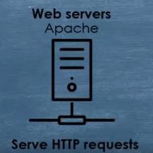


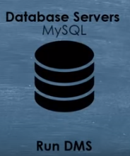

Client Server Architecture
Request
Clients
Servers
Response

Slide 4
What is J2EE (or JEE)
Short for Java 2 Platform Enterprise Edition.
J2EE is a platform-independent, Java-centric environment from Sun/Oracle for developing, building and deploying Web-based enterprise applications online.
The J2EE platform consists of a set of services, APIs, and protocols that provide the functionality for developing multi-tiered, Web-based applications.

Slide 5
Java EE
The Java EE platform is built on top of the Java SE platform.
The Java EE platform provides an API and runtime environment for developing and running
large-scale
multi-tiered
scalable
reliable
secure network applications

Slide 6
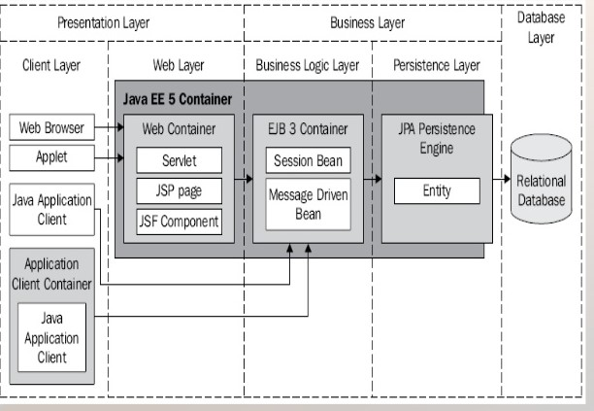
J2EE architecture

Slide 7
Servlets Introduction
Classes that dynamically process requests and construct responses
Dynamically generate html pages in response to requests
May also send data in other forms like XML or serialized Java objects
Run in a servlet container and have access to services that the container provides
Client of the servlet can be any of the following
Browser
Applet
Java Application

Slide 8
Servlets Introduction
Java servlets are efficient and powerful solution for creating dynamic web content.
Servlet is fundamental building block for java based server side web applications.
Power to servlet comes from Java as a platform and interaction with the Servlet container.
Servlet container provides life cycle management, single process to share and manage application-wide resources and interaction with the web server.

Slide 9
Servlets Servlet Lifecycle

Slide 10
Phases of Servlet Lifecycle
Initialization:
–First phase of servlet lifecycle.
–Represents the creation and initialization of resources the servlet needs to service requests.
–The first and foremost thing is to implement the javax.servlet.Servlet interface.
–javax.servlet.Servlet interface defines init() method to match the initialization phase of servlet lifecycle.
–Init() method is called only once when the servlet is created, not for every request.
1.public void init() throws ServletException { //
2.Initialization code... }

Slide 11
Phases of Servlet Lifecycle
Service Phase:
–Service phase of servlet lifecycle represents all interactions with the request until servlet is destroyed.
–Service() method is used to match the service phase by servlet interface.
– Service () method is initialized once per request and is responsible for generating response to that request.
–Servlet specification define service() method to take two parameters:
•javax.servlet.ServiceRequest()
•javax.servlet.ServiceResponse()
–These two objects represent clients request for dynamic resource and servlets response to the client.

Slide 12
Phases of Servlet Lifecycle
Destruction Phase
–This phase represents when servlet is being removed from use by the container.
–To implement this servlet interface defines the destroy() method.
– destroy() method gracefully terminates the servlet and tidy up any occupied resources.

Slide 13
Servlets Servlet Lifecycle
Servlet Container
Create Thread Pool
Thread
Thread
Instantiate servlet
Servlet
Call init ( ) method
Perform Initialization
HTTP Request 1
Call service ( ) method
Allocate request to thread
HTTP Request 2
Call service ( ) method
Allocate request to thread
Perform Service
Shutdown Initiated
Block all further requests Wait for active threads to end
Perform Service
HTTP Response 1
Terminate thread pool
HTTP Response 2
call destroy ( ) method
Perform cleanup
terminate servlet
Servlet destroyed & garbage collected
Container shutdown

Slide 14
Servlets Servlet API
Contained in two packages
javax.servlet
javax.servlet.http
Contains 20 interfaces and 16 classes
Prevalence of interfaces allows servlet implementation to be customized to container

Slide 15
Servlets Servlet API
Servlet interface
Implemented by all servlets
Many methods invoked automatically by server
Similar to applets (paint, init, start, etc.)
abstract classes that implement Servlet
GenericServlet (javax.servlet)
HTTPServlet (javax.servlet.http)
Methods
void init( ServletConfig config )
Automatically called, argument provided

Slide 16
Servlets Servlet API
Methods
ServletConfig getServletConfig()
Returns reference to object, gives access to config info
void service ( ServletRequest request, ServletResponse response )
Key method in all servlets
Provide access to input and output streams
Read from and send to client
void destroy()
Cleanup method, called when servlet exiting

Slide 17
Servlet for Web
Content over web is primarily accessed via HTTP.
To make servlet aware about HTTP there is a special implementation:
Javax.servlet.http.HTTPServlet
HyperText Transfer Protocol:
Is a simple and stateless protocol
It relies on client usually a browser to make a request and a server to send a response.

Slide 18
Hypertext Transfer Protocol
Application level protocol
Request/Response Protocol
Used to communicate data over World Wide Web.
HTTP 1.0/HTTP1.1
Connectionless
Media Independent
Stateless

Slide 19
HTTP Parameters
HTTP Version
HTTP-version=HTTP/1.0 or HTTP/1.1
URI
URI = "http:" "//" host [ ":" port ] [ abs_path [ "?" query ]]
Character set
Default US-ASCII
Content Encoding
Media Type
media-type = type "/" subtype *( ";" parameter )
Language Tag

Slide 20
HTTP Messages
A typical HTTP message
Start Line
Contains plain text based information
Sometimes body contains binary data
Headers
Body

Slide 21
Request/Response Message
Request HTTP Message
Response HTTP Message
Method path/to/file.ext http/version
http/version status code
Name1:Value1
Name2:Value2
Name3:Value3
Name1:Value1
Name2:Value2
Name3:Value3
Some Content
File Requested

Slide 22
Request HTTP Message
Method
URI
Version
GET /myProject/index.html HTTP/1.0
Host: www.myProject.com
Accept: text/html
Accept-language: en-US
Accept-encoding: gzip

Slide 23
Response HTTP Message
HTTP/1.0 200:OK
Success or Error Code
Version
Content-type: text/html
Content-length: 230
Server: Apache/2.2.14(win64)
Date: Mon, 21 Jan 2019 2:30:00 GMT
1xx: Acknowledgement
2xx: Success
3xx: Redirection
4xx: Client Error
5xx: Server Error
myProject/index.html

Slide 24
HTTP Methods
GET-Send data
POST- Send data
HEAD- Responding header only
PUT- replace content
DELETE- Delete resource
TRACE-echo request
OPTIONS-supported HTTP methods
CONNECT-establish connection

Slide 25
Client Request
Server Response
GET /hello.htm HTTP/1.1
User-Agent: Mozilla/4.0 (compatible;
MSIE5.01; Windows NT)
Host: www.tutorialspoint.com
Accept-Language: en-us
Accept-Encoding: gzip, deflate
Connection: Keep-Alive
HTTP/1.1 200 OK
Date: Mon, 27 Jul 2009 12:28:53 GMT
Server: Apache/2.2.14 (Win32)
Last-Modified: Wed, 22 Jul 2009 19:15:56 GMT
Content-Length: 88
Content-Type: text/html
Connection: Closed
<html>
<body>
<h1>Hello, World!</h1>
</body>
</html>

Slide 26
Client Request
Server Response
GET /t.html HTTP/1.1
User-Agent: Mozilla/4.0 (compatible; MSIE5.01; Windows NT)
Host: www.tutorialspoint.com
Accept-Language: en-us
Accept-Encoding: gzip, deflate
Connection: Keep-Alive
HTTP/1.1 404 Not Found
Date: Sun, 18 Oct 2012 10:36:20 GMT
Server: Apache/2.2.14 (Win32)
Content-Length: 230
Content-Type: text/html; charset=iso-8859-1
Connection: Closed
<!DOCTYPE HTML PUBLIC "-//IETF//DTD HTML 2.0//EN">
<html>
<head>
<title>404 Not Found</title>
</head>
<body>
<h1>Not Found</h1>
<p>The requested URL /t.html was not found on this server.</p>
</body>
</html>

Slide 27
HTTP Servlet
HttpServlet is a servlet implementation for embedding HTTP support.
HttpServlet shares the same life cycle as servlet, but with few modifications.
HttpServlet objects implement a modified service() method
For each service request service() method calls one of the seven HTTP helper methods:
doGet(); doPost(); doPut(); doHead(); doOptions(); doDelete() and doTrace().
Appropriate helper method is invoked to match type of method in HTTP request.

Slide 28
HTTP Servlet

Slide 29
Servlets javax.servlet.http
Javax.servlet package provides interfaces and classes to service client requests in protocol independent manner.
Javax.servlet.http package supports http-specific functions.
Several of the classes are derived from the javax.servlet package
Some methods from the javax.servlet package are also used
Contains
8 interfaces
7 classes

Slide 30
Servlets Classes and Interfaces
Interfaces
HttpSession
HttpServletRequest
HttpServletResponse
HttpSessionAttributeListener
HttpSessionActivationListener
HttpSessionBindingListener
HttpSessionContext
HttpSessionListener
Classes
Cookie
HttpServlet
HttpServletRequestWrapper
HttpServletResponseWrapper
HttpSessionBindingEvent
HttpSessionEvent
HttpUtils

Slide 31
GET & POST
HTTP 0.9 first widely used HTTP version had support for only one method – GET
Had a restriction to send only 255 characters to the web server.
HTTP 1.0 introduced POST method.
GET request can provide a limited amount of data in the form of a query.
POST method sends unlimited amount of data over a socket connection as part of HTTP request.
POST method can be used in place of GET but not GET in place of POST.
Servlets handle these methods using doGet() and doPost() methods.

Slide 32
HttpServlet Class
Extends the Generic Servlet
Inherits the init() and destroy methods()
Overrides the service() method
Service() method
Signature: Protected void service(HttpServletRequest req, HttpServletResponse res)
Forwards the request to the appropriate method
Developer should not normally override this method
The developer needs to implement the methods corresponding to the request
doGet(), doPost(), doHead(), doPut(), doOptions(); doDelete() and doTrace().

Slide 33
HttpServletRequest Interface
Extends ServletRequest
Inherited methods from ServletRequest
getParameterNames()
getParameter(String name)
getParameterValues(String name)
getServerName()
getServerPort()
getRequestDispatcher()
New methods defined
getCookies()
getHeader()
getPathInfo()
getContextPath()
getQueryString()

Slide 34
HttpServletResponse Interface
Extends ServletResponse
Inherited methods from ServletResponse
getoutputStream()
getWriter(String name)
flushBuffer()
setContentType()
New methods
encodeURL(String url)
encodeRedirectURL(String url)
setDateHeader()
setStatus()
………

Slide 35
Writing a Servlet
Create a servletclass
extend HttpServlet
Implement the doGet() or doPost() method
Both methods accept two parameters
HttpServletRequest
HttpServletResponse
Obtain parameters from HttpServletRequest Interface using
getParameter(String name)
Obtain the writer from the response object
Process input data and generate output (in html form) and write to the writer
Close the writer

Slide 36
Example- HelloWorld
import java. io.*
import javax.servlet
import javax.servlet.http.*
public class HelloWorld extends HTTPServlet {
public void doGet (Javax.servlet.http.HTTPServletRequest request, javax.servlet.http.HTTPServletResponse response)
throws IOException, ServletException
{
response.setContentType(“text/html”);
PrintWriter out = response.getWriter();
out.println(“<html>”);
out.println(“<head”);
out.println(“<title>Hello World<title>”);
out.println(“</head>”);
out.println(“<body>”);
out.println(“<h1>Hello World</h1>”);
out.println(“</body>”);
out.println(“</html>”);
}
}

Slide 37
Deploying a Servlet
Servlet is not a full java application and relies on container services.
Generating responses using servlet involves both creating the servlet and deploying the servlet.
Servlet is not placed in the root directory of application but instead is placed in the /WEB-INF/classes directory of the application.
Hence deployment requires a unique set of url’s to be declared in web application’s deployment descriptor.
This descriptor file is web.xml file.

Slide 38
Deployment Descriptor
Deployment has two elements:
1st Element: Servlet
2nd Element: Servlet-mapping
Servlet element is used to define the servlet that should be loaded by the web application.
Servlet-mapping element is used to map a servlet to a given url or set of url’s.

Slide 39
Example-web.xml
<?xml version="1.0" encoding="ISO-8859-1"?>
<web-app>
<servlet>
<servlet-name>HelloWorld</servlet-name>
<servlet-class> xxx.HelloWorld</servlet-class>
</servlet>
<servlet-mapping>
<servlet-name>HelloWorld</servlet-name>
<url-pattern>/HelloWorld</url-pattern>
</servlet-mapping>
</web-app>

Slide 40
Example- Login
import javax.servlet.http.*;
import java.io.*;
public class Login extends HttpServlet {
public void doPost(HttpServletRequest request, HttpServletResponse response) {
// Get the parameter from the request
String username = request.getParameter("username");
// Send the response back to the user
try {
response.setContentType("text/html");
PrintWriter writer = response.getWriter();
writer.println("<html><body>");
writer.println("Thank you, " + username + ". You are now logged into the system.");
writer.println("</body></html>");
writer.close();
} catch (Exception e) {
e.printStackTrace();
}
}
}

Slide 41
Login.html
<html>
<head>
<title>Login</title>
</head>
<body>
<h1>Login</h1>
Please enter your username and password
<form action="Login" method="POST">
<p><input type="text" name="username" length="40">
<p><input type="password" name="password" length="40">
<p><input type="submit" value="Submit">
</form>
</body>
</html>

Slide 42
Web.xml
<?xml version="1.0" encoding="ISO-8859-1"?>
<!DOCTYPE web-app
PUBLIC "-//Sun Microsystems, Inc.//DTD Web Application 2.3//EN"
"http://java.sun.com/dtd/web-app_2_3.dtd">
<web-app>
<display-name>Login Servlet</display-name>
<servlet>
<servlet-name>Login</servlet-name>
<servlet-class>Login</servlet-class>
</servlet>
<servlet-mapping>
<servlet-name>Login</servlet-name>
<url-pattern>/Login</url-pattern>
</servlet-mapping>
</web-app>

Slide 43
RequestDispatcher Interface
Dispatching the request to another resource it may be html, servlet or jsp.
Used to include the content of another resource also

Slide 44
forward method
public void forward(ServletRequest request,ServletResponse response) throws ServletException, java.io.IOException
Forwards a request from a servlet to another resource (servlet, JSP file, or HTML file) on the server.

Slide 45
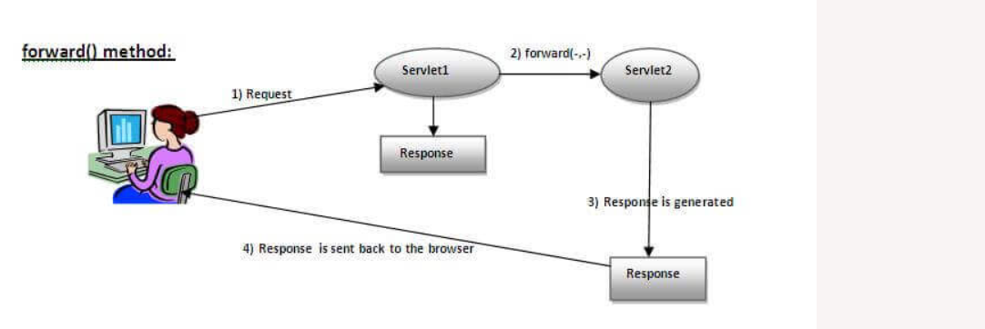

Slide 46
include method
public void include(ServletRequest request,ServletResponse response) throws ServletException,java.io.IOException
Includes the content of a resource (servlet, JSP page, or HTML file) in the response.

Slide 47
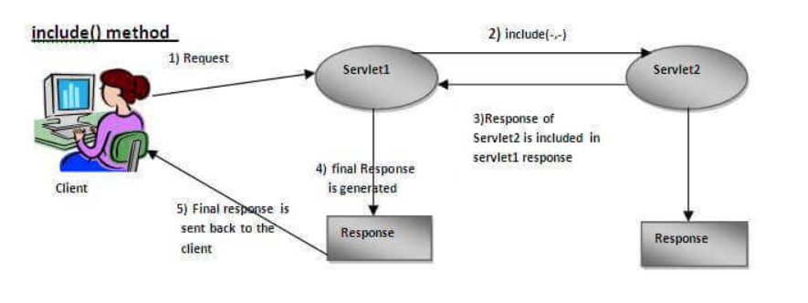

Slide 48
Getting object of Requestdispatcher
public RequestDispatcher getRequestDispatcher(String resource);
RequestDispatcher rd=request.getRequestDispatcher("servlet2");
//servlet2 is the url-pattern of the second servlet
rd.forward(request, response);//method may be include or forward

Slide 49
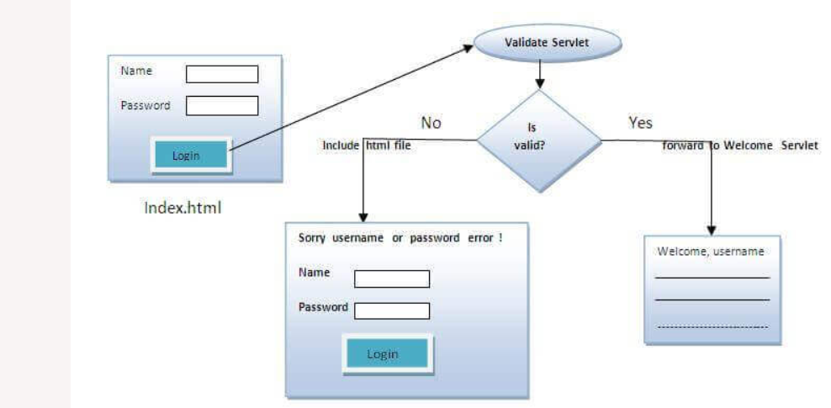

Slide 50
Index.html
<form action="servlet1" method="post">
Name:<input type="text" name="userName"/><br/>
Password:<input type="password" name="userPass"/><br/>
<input type="submit" value="login"/>
</form>

Slide 51
Login.java
public void doPost(HttpServletRequest request, HttpServletResponse response)
throws ServletException, IOException {
response.setContentType("text/html");
PrintWriter out = response.getWriter();
String n=request.getParameter("userName");
String p=request.getParameter("userPass");
if(p.equals("servlet"){
RequestDispatcher rd=request.getRequestDispatcher("servlet2");
rd.forward(request, response);
}
else{
out.print("Sorry UserName or Password Error!");
RequestDispatcher rd=request.getRequestDispatcher("/index.html");
rd.include(request, response);
}
}

Slide 52
Welcome.java
public void doPost(HttpServletRequest request, HttpServletResponse response)
throws ServletException, IOException {
response.setContentType("text/html");
PrintWriter out = response.getWriter();
String n=request.getParameter("userName");
out.print("Welcome "+n);
}

Slide 53
Web.xml
<servlet>
<servlet-name>Login</servlet-name>
<servlet-class>Login</servlet-class>
</servlet>
<servlet>
<servlet-name>WelcomeServlet</servlet-name>
<servlet-class>WelcomeServlet</servlet-class>
</servlet>
<servlet-mapping>
<servlet-name>Login</servlet-name>
<url-pattern>/servlet1</url-pattern>
</servlet-mapping>
<servlet-mapping>
<servlet-name>WelcomeServlet</servlet-name>
<url-pattern>/servlet2</url-pattern>
</servlet-mapping>

Slide 54
sendRedirect()
method of HttpServletResponse interface
It works at client side because it uses the url bar of the browser to make another request.
response.sendRedirect("http://www.google.com");

Slide 55
Difference between forward() and sendRedirect() method
forward() method | sendRedirect() method
The forward() method works at server side. | The sendRedirect() method works at client side.
It sends the same request and response objects to another servlet. | It always sends a new request.
It can work within the server only. | It can be used within and outside the server.
Example: request.getRequestDispacher("servlet2").forward(request,response); | Example: response.sendRedirect("servlet2");

Slide 56
Tracking state

Slide 57
Cookies
A Cookie is data (String) that the server passes to the browser and the browser stores on the server
Set of name value pairs
Web servers place cookies on user machines with id to track the users
Two types of cookies
Persistent cookies: Stored on hard drive in text format
Non-persistent cookies: Stored in memory and goes away after you reboot or turn off the machine

Slide 58
Cookie Attributes
Attributes of a cookie
Name: Name of a cookie
Value: Value of the cookie
Comment: Text explaining purpose of cookie
Max-Age: Time in seconds after which the client should not send cookie back to server
Domain: Domain to which the cookie should be sent
Path: The path to which the cookie should be sent
Secure: Specifies if cookie should be sent via https
Version: Cookie version
(0 – original Netscape version of Cookie
1 – cookies standardized via RFC 2109)

Slide 59
Cookie Constructor
Cookie() | constructs a cookie.
Cookie(String name, String value) | constructs a cookie with a specified name and value.

Slide 60
Useful Methods
Method | Description
public void setMaxAge(int expiry) | Sets the maximum age of the cookie in seconds.
public String getName() | Returns the name of the cookie. The name cannot be changed after creation.
public String getValue() | Returns the value of the cookie.
public void setName(String name) | changes the name of the cookie.
public void setValue(String value) | changes the value of the cookie.

Slide 61
Other Methods
public void addCookie(Cookie ck):method of HttpServletResponse interface is used to add cookie in response object.
public Cookie[] getCookies():method of HttpServletRequest interface is used to return all the cookies from the browser.

Slide 62
Cookie Servlet
public class CookieServlet extends HttpServlet
{
protected void doGet(HttpServletRequest request,HttpServletResponse response) throws ServletException, IOException
{
Cookie[] cookies = request.getCookies();
Cookie token = null;
if(cookies != null) {
for(int i = 0; i < cookies.length; i++)
{
if(cookies[i].getName().equals("token")) {
// Found a token cookie
token = cookies[i];
break;
}
}
}

Slide 63
Cookie Servlet
response.setContentType("text/html");
PrintWriter writer = response.getWriter();
writer.println("<html><head><title>Tokens</title></head><body ");
writer.println("style=\"font-family:verdana;font-size:10pt\">");
String reset = request.getParameter("reset");
System.out.println("token = " + token);
if (token == null || (reset != null && reset.equals("yes"))) {
Random rand = new Random();
long id = rand.nextLong();
writer.println("<p>Welcome. A new token " + id + " is now established</p>");
// Set the cookie
token = new Cookie("token", Long.toString(id));
token.setComment("Token to identify user");
token.setMaxAge(-1);
token.setPath("/cookie/track");

Slide 64
Cookie Servlet
response.addCookie(token);
} else {
writer.println("Welcome back. Your token is " + token.getValue() + ".</p>"); }
String requestURLSame = request.getRequestURL().toString();
String requestURLNew = request.getRequestURL() + "?reset=yes";
writer.println("<p>Click <a href=" + requestURLSame +
">here</a> again to continue browsing with the same identity.</p>");
writer.println("<p>Otherwise, click <a href=" + requestURLNew +
">here</a> again to start browsing with a new identity.</p>");
writer.println("</body></html>");
writer.close();
}
}

Slide 65
Hidden Form Field
<input type="hidden" name="uname" value="Vimal Jaiswal">

Slide 66
URL Rewriting
In URL rewriting, we append a token or identifier to the URL of the next Servlet or the next resource. We can send parameter name/value pairs using the following format:
url?name1=value1&name2=value2&??
out.print("<a href='servlet2?uname="+n+"'>visit</a>");
String n=request.getParameter("uname");

Slide 67
HttpSession interface
container creates a session id for each user
public HttpSession getSession():Returns the current session associated with this request, or if the request does not have a session, creates one.
public HttpSession getSession(boolean create):Returns the current HttpSession associated with this request or, if there is no current session and create is true, returns a new session.

Slide 68
Methods
public String getId():Returns a string containing the unique identifier value.
public long getCreationTime():Returns the time when this session was created.
public long getLastAccessedTime():Returns the last time the client sent a request associated with this session.
public void invalidate():Invalidates this session then unbinds any objects bound to it.

Slide 69
Accessing Session Values
session.setAttribute("uname",n);
String n=(String)session.getAttribute("uname");

